Slide 1


Faltung (Konvolution) ?
in Gefaltetes Neuronales Netzwerk

Slide 2
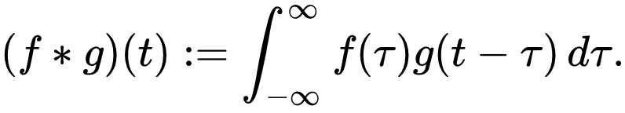
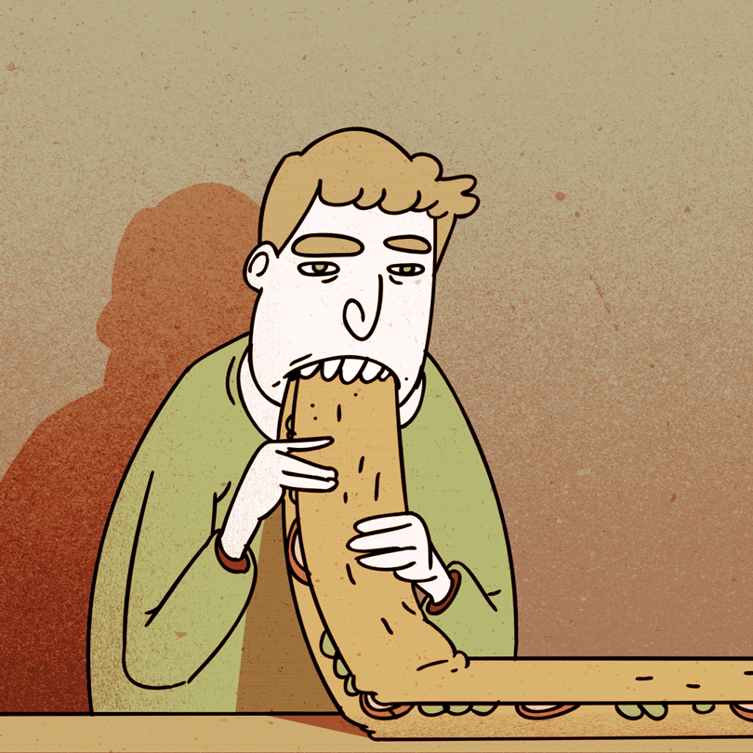
Faltung ist wie folgt definiert:
Umdrehen: g(τ) → g(-τ)
Verschieben: g(t - τ) -∞ < t < ∞
Berechnen der Flächenüberlappung: f(τ) g(t - τ)
Notes:
Think of f(t) as the image and g(t) as the mask although you can reverse their roles!
Definitionsmenge --- Zielmenge

Slide 3
Spaghetti
Jogurt
Apfel
Input (Essen)
Rührei
Input (Essen): f(t)
8
10
12
14
16
t (Uhr)
Verdauen
(Restnahrungsrate)
Verdauen: g(t)
2
4
6
8
10
t (Std.)

Slide 4
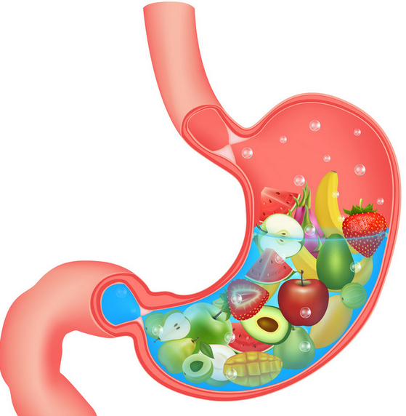

f(t)
Input (Essen)
8
10
12
14
16
t (Uhr)
g(t)
Input (Essen)
Verdauen
(Restnahrungsrate)
8
10
12
14
16
t (Uhr)
2
4
6
8
10
t (Std.)

Slide 5
Input (Essen)
8
10
12
14
16
t (Uhr)
Notes:
wie viel Nahrung im Magen verbleibt (wie viel Essen im Magen bleibt)?

Slide 6
Input (Essen) f(t)
= f(12) * g(14-12)
8
10
12
14
16
t (Uhr)
Verdauen
(Restnahrungsrate) g(t)
=
f(12) *
g(14-12)
2 St. Später
2
4
6
8
10
t (Std.)

Slide 7

Input (Essen) f(t)
= f(12) * g(14-12)
8
10
12
14
16
t (Uhr)
= f(10) * g(14-10)
Verdauen
(Restnahrungsrate) g(t)
= f(12) * g(14-12)
=
f(10) *
g(14-10)
2
4
6
8
10
t (Std.)

Slide 8
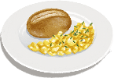
Input (Essen) f(t)
= f(12) * g(14-12)
+
8
10
12
14
16
t (Uhr)
= f(10) * g(14-10)
+
= f(12) * g(14-12)
Verdauen
(Restnahrungsrate) g(t)
= f(10) * g(14-10)
= f(8) * g(14-8)
= f(8) * g(14-8)
2
4
6
8
10
t (Std.)

Slide 9
Input (Essen) f(t)
= f(12) * g(14-12)
+
8
10
12
14
16
t (Uhr)
= f(10) * g(14-10)
+
= f(12) * g(14-12)
Verdauen
(Restnahrungsrate) g(t)
= f(10) * g(14-10)
= f(8) * g(14-8)
= f(8) * g(14-8)
2
4
6
8
10
t (Std.)

Slide 10
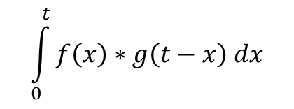
Input (Essen) f(t)
= f(x) * g(t-x)
x
t
t (Uhr)
… …
Verdauen
(Restnahrungsrate) g(t)
=
f(x) *
g(t-x)
$$\int_{0}^{t}{f\left(x\right)∗g\left(t−x\right) dx}$$
t-x
t (Std.)

Slide 11
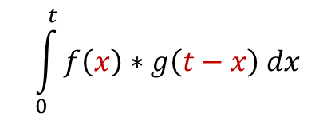
Input (Essen) f(t)
= f(x) * g(t-x)
x
t
t (Uhr)
… …
Verdauen
(Restnahrungsrate) g(t)
=
f(x) *
g(t-x)
$$\int_{0}^{t}{f\left(x\right)∗g\left(t−x\right) dx}$$
t-x
t (Std.)

Slide 12
Input (Essen) f(t)
= f(x) * g(t-x)
t
t (Uhr)
… …
Verdauen
(Restnahrungsrate) g(t)
= f(x)*g(t-x)
$$\int_{0}^{t}{f\left(x\right)∗g\left(t−x\right) dx}$$
t (Std.)

Slide 13
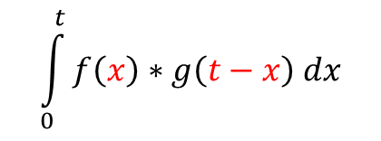
Input (Essen) f(t)
= f(x) * g(t-x)
t
t (Uhr)
… …
Verdauen
(Restnahrungsrate) g(t)
= f(x)*g(t-x)
$$\int_{0}^{t}{f\left(x\right)∗g\left(t−x\right) dx}$$
t (Std.)

Slide 14
Input (Essen) f(t)
t
t (Uhr)
Verdauen
(Restnahrungsrate) g(t)
= f(x)*g(t-x)
t (Std.)

Slide 15
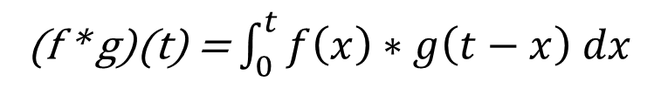
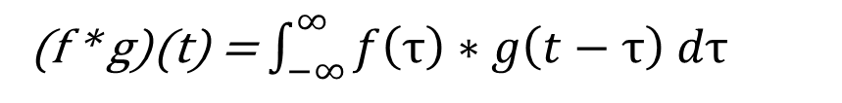
Input (Essen) f(t)
System: Verdauen (stabil)
t
t (Uhr)
(f * g)(t) = $\int_{0}^{t}{f\left(x\right)∗g\left(t−x\right) dx}$
(f * g)(t) = $\int_{−∞}^{∞}{f\left(τ\right)∗g\left(t−τ\right) d\text{τ}}$
Verdauen
(Restnahrungsrate) g(t)
= f(x)*g(t-x)
t (Std.)

Slide 16
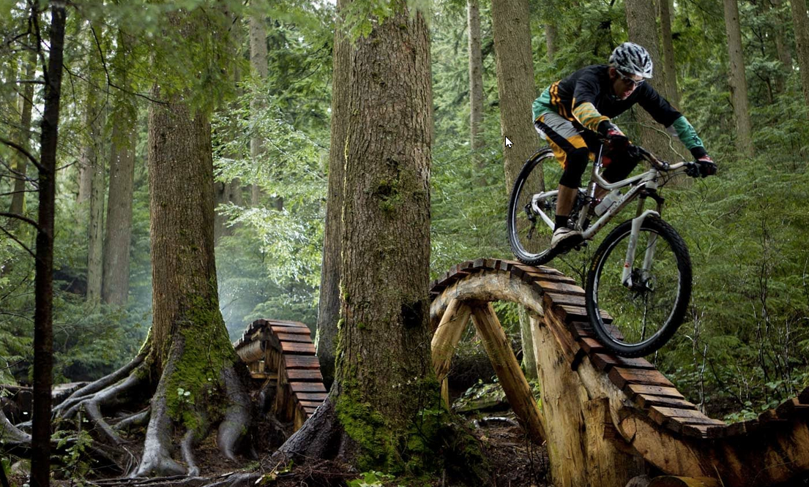

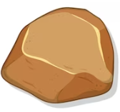
Eingabe (Input)
die Größe des Steins ~ Schwingungsamplitude (das Ausmaß der Verformung)
Notes:
Der Eingang des Signals hängt von der Größe des Steins ab.

Slide 17

Impuls-Signal f(t)
System: Fahrradgabel
0
1
2
3
…
t
System: Fahrradgabel g(t)
0
t

Slide 18
Impuls-Signal f(t)
Output
f(τ)g(0)
f(1)g(0)
f(2)g(0)
f(3)g(0)
f(1)
f(2)
f(τ)
f(3)
…
0
1
2
τ
3
…
t
1
2
τ
3
t
t
System: Fahrradgabel g(t)
f(3)g(t-3)
f(2)g(t-2)
∑
f(1)g(t-1)
…
f(τ)g(t- τ)
0
t

Slide 19
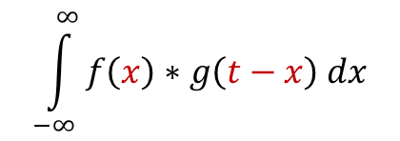
Take Home Messages
„CNN“ < Deep Learning < Maschinelles Lernen < Künstliche Intelligenz
Maschinelles Lernen:
Überwachtes Lernen
Unüberwachtes Lernen
Bestärkendes Lernen
Deep learning: CNN …
Faltung:
System (stabil): g(x)
Input (untabil): f(x)
$$\int_{−∞}^{∞}{f\left(x\right)∗g\left(t−x\right) dx}$$
Notes:
Künstliche Fähigkeit
Definitionsmenge --- Zielmenge

Slide 20
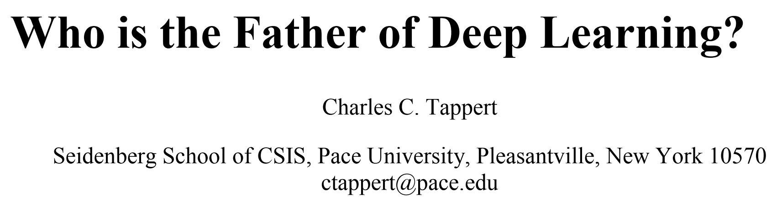
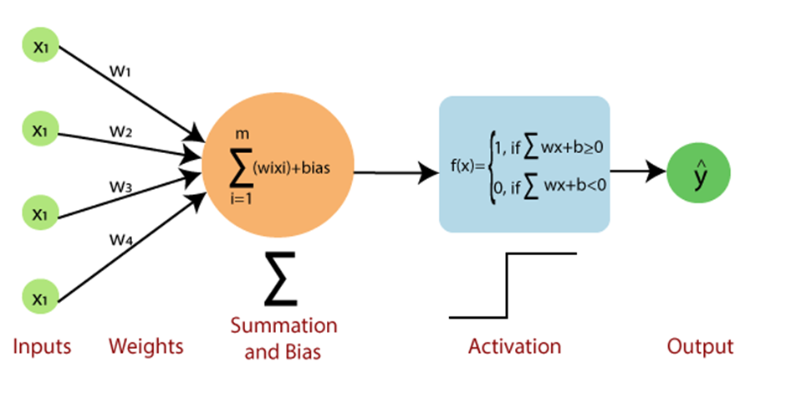
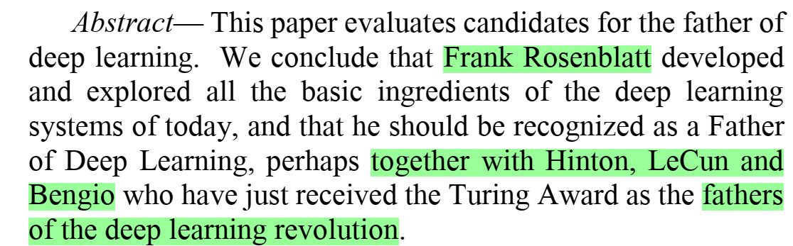
Nächste Schritte
Perzeptron
Rosenblatt, 1958
G:\SD_623\623-1_Geodaten_Stadtvermessung\623-1_Allgemein\623-1_Alle\zhao\KI_Austauschen
Georg: 23-1723

Slide 21
Linear algebra
Calculus (integral / differential)
Probability theory
Optimization
Signal processing
Programming
Algorithm
High-performence computing
Lineare Algebra
Mathematik (Integral-/Differentialrechnung)
Wahrscheinlichkeitsrechnung
Optimierung
Signalverarbeitung
Programmierung
Algorithmus
Hochleistungsrechnen

Slide 23
Künstliche Intelligenz
fidelity to human performance
rationality—loosely speaking, doing the “right thing” (abstrakt)
-- Human vs. Rationality
Internal thought und reasoning
External intelligent behavior
-- Thought vs. Behavior
Notes:
Künstliche Fähigkeit

Slide 24
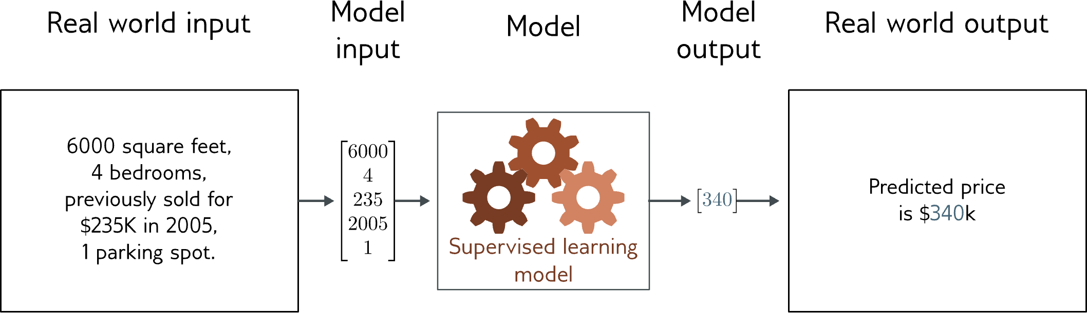
Regression
This regression model takes a vector of numbers that characterize a property and predicts its price.
Univariate regression problem (one output, real value)
Fully connected network
Notes:
The model in figure 1.2a predicts the price of a house based on input characteristics such as the square footage and the number of bedrooms. This is a regression problem because the model returns a continuous number (rather than a category assignment).

Slide 25
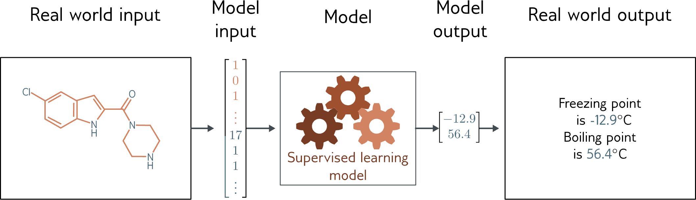
Graphische Regression
This multivariate regression model takes the structure of a chemical molecule and predicts its melting and boiling points.
Multivariate regression problem (>1 output, real value)
Graph neural network
Notes:
In contrast, the model in 1.2b takes the chemical structure of a molecule as an input and predicts both the melting and boiling points. This is a multivariate regression problem since it predicts more than one number.

Slide 26
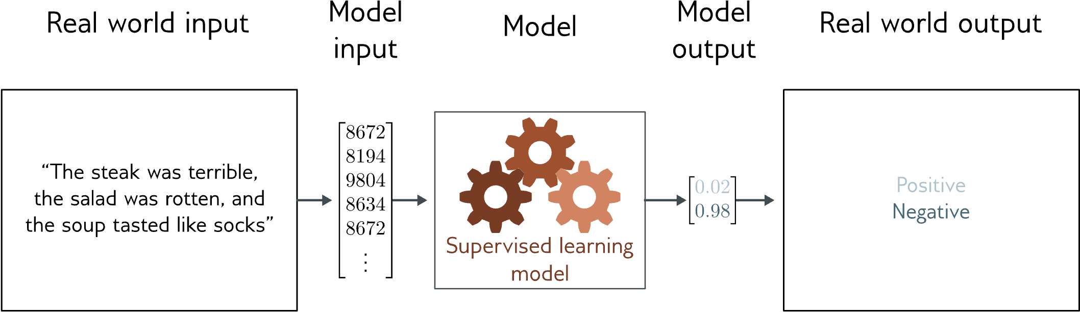
Klassifizierung von Texten
This binary classification model takes a restaurant review and classifies it as either positive or negative.
Binary classification problem (two discrete classes)
Transformer network
Notes:
The model in figure 1.2c receives a text string containing a restaurant review as input and predicts whether the review is positive or negative. This is a binary classification problem because the model attempts to assign the input to one of two categories. The output vector contains the probabilities that the input belongs to each category.

Slide 27
Unüberwachtes Lernen
Lernen über einen Datensatz ohne Markierungen
Clustering
Ausreißer entdecken
Generierung neuer Beispiele
Ergänzen fehlender Daten
Unüberwachtes Lernen

